Slide 1
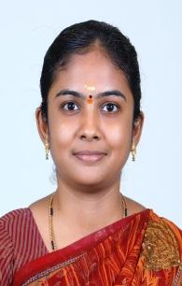
TRINITY COLLEGE FOR WOMEN (Arts & Science) Trinity Nagar ,Mohanur Road, Namakkal-637002,TamilNadu ,India (Permanent Affiliation Granted by Periyar University, Salem-II 2f & 12(b) Status Granted by UGC,New Delhi. Accredited by ‘NAAC’ with A+ Grade ) www.trinitycollegenkl.edu.in
Observation of International Plastic Free Day
Youth Red Cross Conducts a Programme
“Plastic Gives a Helpful hand, But they are
Polluting our Land”
Date : 03.07.2023
Time : 02.00 PM
Resource Person :Dr.S.Kalaivani,
Assistant Professor in Chemistry
Trinity College for Women,
Namakkal
All are Warmly Invited

