Slide 1
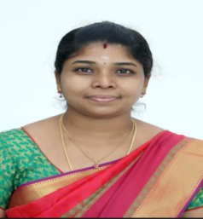
TRINITY COLLEGE FOR WOMEN (Arts & Science) Trinity Nagar ,Mohanur road, Namakkal-637002,TamilNadu ,India (Permanent Affiliation Granted by Periyar University,Salem-II 2f & 12(b) Status Granted by UGC,New Delhi. Accredited by ‘NAAC’ with A+ Grade)
“Observation of World Paper Bag Day”
Youth Red Cross Conducts a Programme
Topic : Why should we select to use paper bag in the place of
polythene bags
Date : 12.07.2023
Time : 02.00 PM
Resource Person : Dr.R.Suba,
Assistant Professor in Commerce,
Trinity College for Women,
Namakkal
All are Warmly Invited

