Slide 1
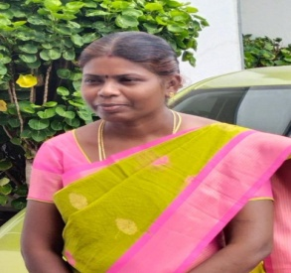
TRINITY COLLEGE FOR WOMEN (Arts & Science) Trinity Nagar ,Mohanur Road, Namakkal-637002,TamilNadu ,India (Permanent Affiliation Granted by Periyar University,Salem-II 2f & 12(b) Status Granted by UGC,New Delhi Accredited by ‘NAAC’ with A+ Grade ) www.trinitycollegenkl.edu.in
Youth Red Cross Conducts a Webinar
“Celebration of World youth skills Day ”
Topic : How to develop Youth Skills through the Naan
Mudhalavan Scheme?
Date : 15.07.2023
Time : 11.00 AM
Resource Person : Dr.B.Vishnupriya,
Assistant Professor in Tamil,
Coordinator,
Naan Mudhalavan Scheme,
Trinity College for Women,
Namakkal
All Are Cordially Invited

