Slide 1
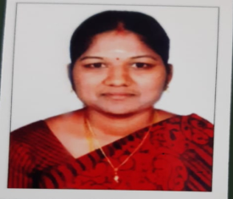
TRINITY COLLEGE FOR WOMEN (Arts & Science) Trinity Nagar ,Mohanur Road ,Namakkal-637002,TamilNadu ,India (Permanent Affiliation Granted by Periyar University,Salem-II 2f & 12(b) Status Granted by UGC, New Delhi Accredited by ‘NAAC’ with A+ Grade) www.trinitycollegenkl.edu.in
Youth Red Cross Conducts
“ An Orientation Programme for first year undergraduate Students”
Date : 19.07.2023
Time : 02.00 PM
Resource Person: Mrs.V.Kalaivani,
Assistant Professor in Physics,
YRC Programme Officer,
Trinity College for Women,
Namakkal.
All are Warmly Invited

