Slide 1
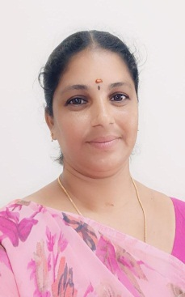
TRINITY COLLEGE FOR WOMEN (Arts & Science) Trinity Nagar ,Mohanur Road ,Namakkal-637002,TamilNadu ,India (Permanent Affiliation Granted by Periyar University,Salem-II 2f & 12(b) Status Granted by UGC, New Delhi Accredited by ‘NAAC’ with A+ Grade) www.trinitycollegenkl.edu.in
“Observation of World Drowning Prevention Day”
Youth Red Cross Conducts a programme on
“Drowning- Precautions, Preventions and Realities”
Date : 25.07.2023
Time : 02.00 PM
Resource Person : Mrs.V.Archana
Physical Director,
Trinity College for Women,
Namakkal.
All Are Warmly Invited

